Slide 1
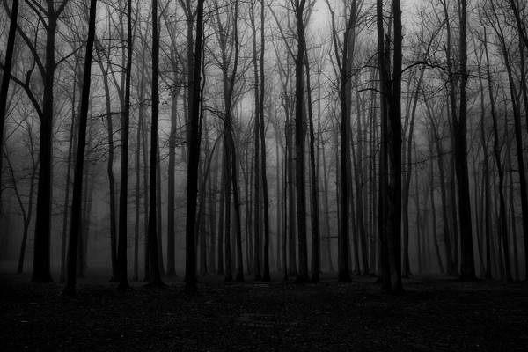
Global Suicide Trends & Analysis
Vaishali | Chandni | Gaurav | Jie | Javier | Duane | Liangliang | Wing
Working Together to Prevent Suicide

Slide 2



Did you KNOW?
15/100k
15 per 100k
8 per 100k
Over 800,000 people die by suicide per year
15th leading cause of death
1 per 40 secs
Notes:
World Suicide Prevention Day (WSPD), on 10 September, is organized by the International Association for Suicide Prevention (IASP).
WHO has been co-sponsor of the day. The purpose of this day is to raise awareness around the globe that suicide can be prevented.
In past years, over 300 activities in around 70 countries were reported to IASP, including educational and commemorative events, press briefings and conferences, as well as Facebook and Twitter coverage.
https://www.who.int/mental_health/prevention/suicide/wspd/en/

Slide 3
Agenda
Global trend
find answers-
Are high HDI and suicide rate related?
Rich countries have higher rate?
Did the rate raise during recession 2007-08?
Trend in rich countries
Trend in Canada, UK, US, France and Ireland
Trend from 2010-2015
External factors
Conclusions
Notes:
depressed

Slide 4

About Data
Source : kaggle
Format : csv
Shape : 27,820 x 12
HDI missing for half of the data
Limitations:
No reasons mentioned
data for only 93 countries
No data for populous countries like India, China.
Categorical | Numerical
Country Year Sex Age Generation | Number of Suicides Suicides per 100k population GDP for year GDP per capita HDI

Slide 5
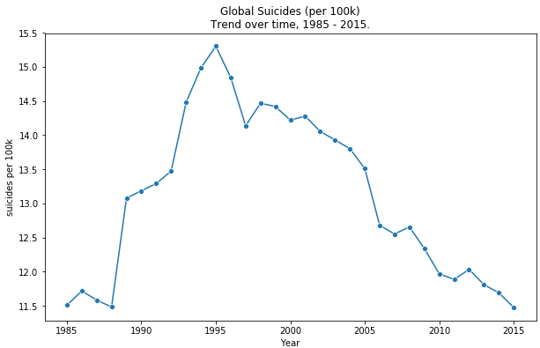
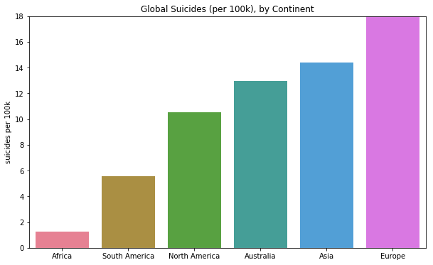
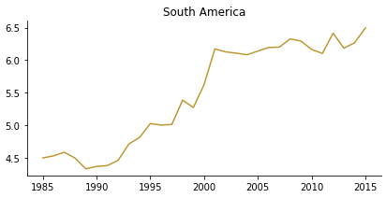
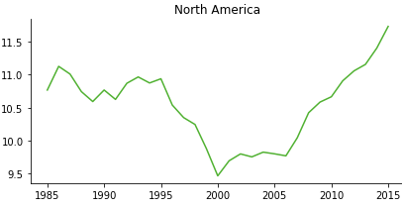
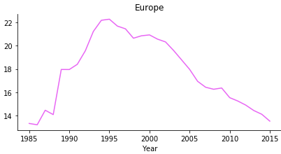
Global Trend - Continents
Peak was 15.3/100k in 1995
Decreased to 11.5/100k in 2015 (~25% decrease)
European rate was the highest overall
Africa is underrepresented
European rate decreasing since 1995
Americas' trends are more concerning
Notes:
impulsive

Slide 6
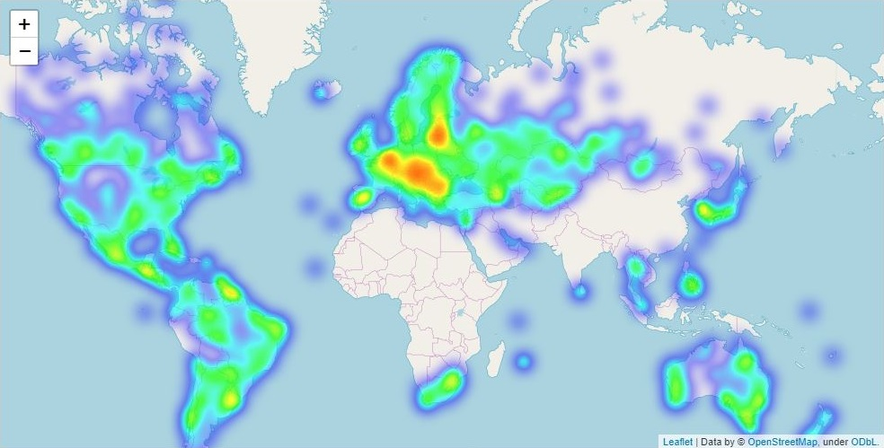
Global Trend-Worldwide
Note the lack of data for Africa and Asia
European countries with high rates, few with low rates
Notes:
impulsive

Slide 7
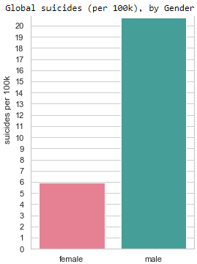
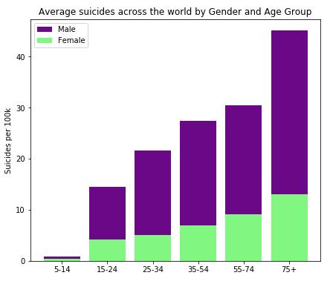
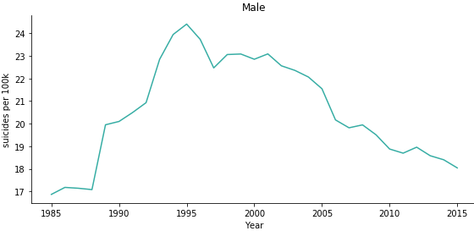
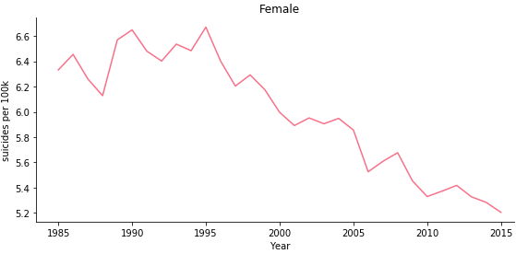
Global Trend-Gender ratio
Rate for men has been ~3.5x higher
Rate for age ‘5-14’ is small(< 1/100k)
Men of all age groups have higher suicide rate
Likelihood increased with age
Rate remained constant since the mid 90’s
ratio 3.5 : 1 remained relatively constant since mid 90’s
Notes:
crying out for help

Slide 8
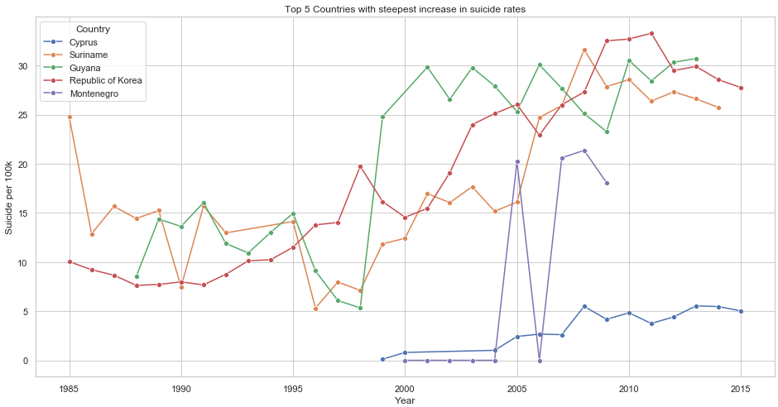
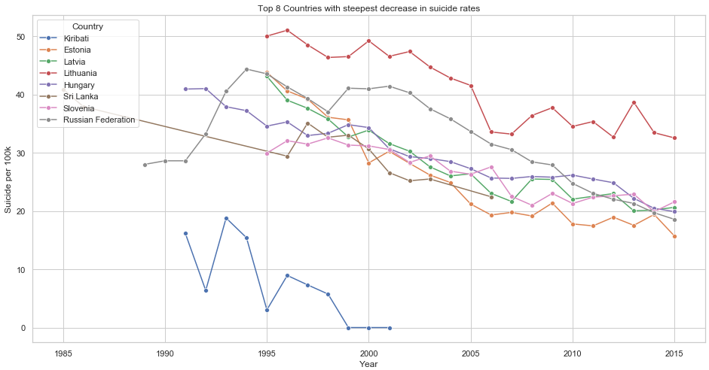
Global Trend- Countries with steepest rates
Lithuania has the steepest increase of > 41 suicides/100k (per year)
Korea shows the most concerning trend - an increase in suicide of 0.931 people (per 100k, per year)
Guyana’s rate increased enormously from 5.3 to 24.8 during 1998-1999
Estonia shows the steepest decrease every year, ~1.31 less people/100k (per year)
Dropped from 43.8 to 15.7 per 100k (per year) during 1995-2015 - a 64% decrease
Notes:
crying out for help

Slide 9
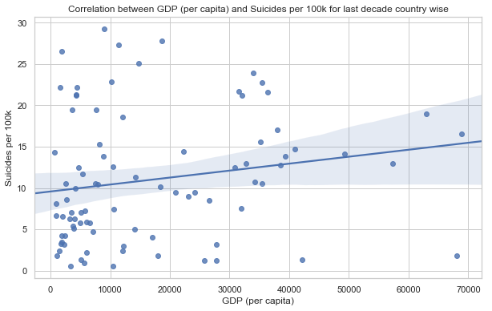
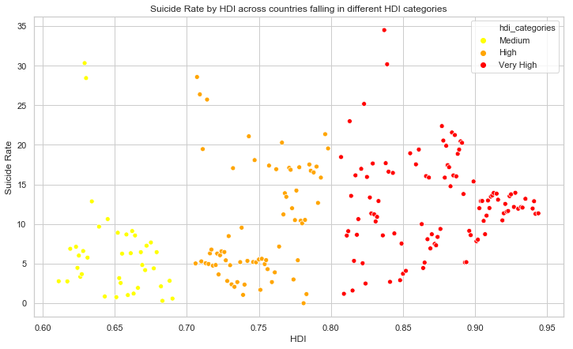
Find Answers
Do richer countries have a higher rate of suicide?
Richer countries are associated with higher rates of suicide
Suicides = 8.7718 + 0.1115 * GDP
HDI & SUICIDE RATE
for 2006 to 2015
Countries group into - Very High, High, Medium and Low
exists a correlation of 0.43
Indicates high rates among countries with HDI.
RECESSION 2007-08
GDP & suicide rate have a weak negative correlation of -0.105.
Notes:
Made a mistake
-- 38countries report having a national strategy for suicide prevention

Slide 10
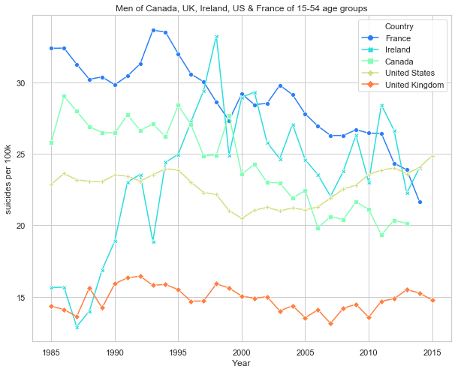
Trends in developed Countries
Young to Middle-Aged Men from Canada, UK, US, Ireland and France
Canada shows downward trend. A decrease of ~35% from 1995-2006.
Ireland’s concerning. Went from ~14 (per 100k, per year) to 33 between 1988 and 1998 - an increase of ~135%
US shows the most concerning upward trend
Notes:
have a philosophical desire to die

Slide 11
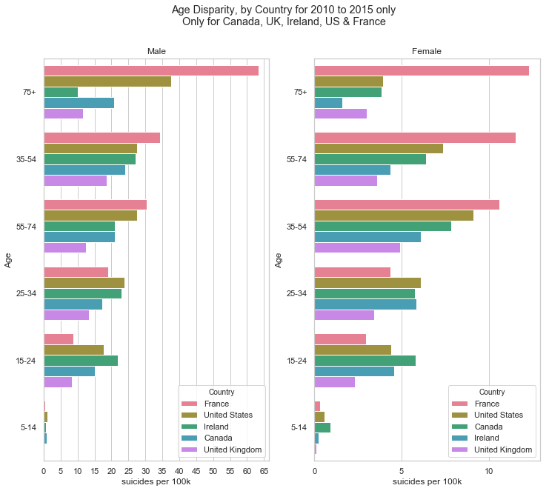
Recent trends in Developed countries
2010 - 2015 for Canada, UK, US, Ireland and France
Suicide rate increases with age for France, and US (to a lesser extent)
35-54 at the highest risk in Canada, Ireland and the UK which follow closer to a gaussian distribution
In US, suicide rate for men and women continues to increase with age, but the female rate decreases in old age
Canada has the lowest suicide rate in every sex-age group
Notes:
have a philosophical desire to die

Slide 12
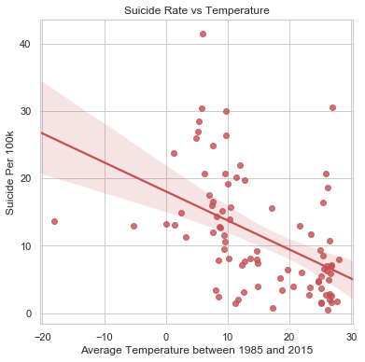
External Factor influencing suicide rate
Sun exposure is related to vitamin D linked with mental health and depression
Sun exposure is related to melatonin related to sleep quality
We integrated the data from Kaggle -Climate Change: Earth Surface Temperature Data with suicide data.
-Ve correlation between average temperature of a country and its suicide rate
For the countries in our data, average temperature plays a role!

Slide 13
Conclusion
Suicide rates are decreasing globally
2/3 of countries show clear linear decreasing trends over time
On average, suicide rate increases with age for Americas, Asia & Europe, but not Africa
a weak positive relationship found between GDP (per capita) and suicide rate
overrepresentation of men at every level of analysis- globally, at a continent and country level).
Globally, the male rate is ~3.5x higher.
Average temperature of a country has a weak negative correlation with it's suicide rate. But, this is not a Universal factor.

Slide 14



Thank you
World Suicide Prevention Day
10 September, 2019
PREVENT SUICIDE: TEND THE HAND AND SAVE LIVES
Notes:
https://www.iasp.info/wspd2019/
Light a Candle near a Window at 8 PM to show your support for suicide prevention, to remember a lost loved one, and for the survivors of suicide.

